Slide 1

Bird Strike Analysis 2000-2011
Presented By: Bhawna Goyal Data Analyst Intern, Unified Mentors

Slide 2
About Bird Strike
Bird Strike is common and can be a significant threat to aircraft safety. For smaller aircraft, significant damage may be caused to the aircraft structure and all aircraft, especially jet- engined ones, are vulnerable to the loss of thrust which can follow the ingestion of birds into engine air intakes.

Slide 3
What happen after bird strike ?
Naturally, bird strikes almost always damage the forward-facing areas of the aircraft - the windscreen, nose cone, and engines. This can force the plane to perform an emergency landing

Slide 4
Goal :
Visuals Depicting the Number of Bird Strikes
Yearly Analysis & Bird Strikes in the US
Top 10 US Airlines in terms of having encountered bird strikes
Airports with most incidents of bird strikes – Top 50
Yearly Cost Incurred due to Bird Strikes:
When do most bird strikes occur?
Altitude of airplanes at the time of strike
Phase of flight at the time of the strike
Average Altitude of the airplanes in different phases at the time of strike
Effect of Bird Strikes & Impact on Flight
Effect of Strike at Different Altitude
Were Pilots Informed? & Prior Warning and Effect of Strike Relation

Slide 5

About Data
There’s numerous features & factors on which our analysis of bird strike depends.
Dataset contains :
It contains 25 attributes in which main attribute is :
→ How much no. of bird strike happen & i.e. (Wildlife: Number Struck Actual)

Slide 6
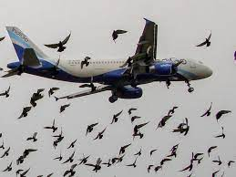
Process
Data Gathering
Data Preparation
Remove Null Values i.e. Data Cleanup
Dashboard Designing
Analysis each & every factor

Slide 7
Tool used:
Ms-Excel
Power BI

Slide 8
INSIGHTS

Slide 9

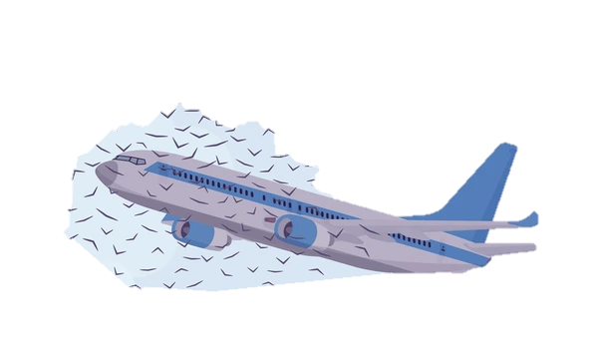
Number of Bird Strikes ?
Total cost for Aircraft Repairing ?
68K
140M

Slide 10
Number Struck Actual trended up, resulting in a 160.80% increase between January 2000 and October 2011.﻿﻿ ﻿﻿
Number Struck Actual started trending up on July 2008, rising by 34.50% (797) in 12 quarters.﻿﻿ ﻿﻿ ﻿﻿
Number Struck Actual jumped from 2310 to 3107 during its steepest incline between July 2008 and July 2011.﻿﻿ ﻿﻿
Number Struck Actual was highest for New York at 1209, followed by Pennsylvania and North Carolina.﻿﻿ ﻿﻿ ﻿﻿New York accounted for 25.93% of Number Struck Actual.﻿﻿ ﻿﻿ ﻿﻿

Slide 11
At 9281, BUSINESS had the highest Wildlife Struck Actual and was 494.17% higher than JETBLUE AIRWAYS, which had the lowest Wildlife Struck Actual at 1562.﻿﻿ ﻿﻿
Across all 10 Aircraft: Airlines, have Wildlife Struck Actual ranged from 1562 to 9281.﻿﻿ ﻿﻿ ﻿
﻿Total Cost($) trended up, resulting in a 157.68% increase between 2000 and 2011.﻿﻿ ﻿
Total $ dropped from 23162777 to 18302373 during its steepest decline between 2001 and 2006.﻿﻿ ﻿﻿ ﻿﻿

Slide 12
Project link : https://drive.google.com/file/d/1TgRKA_PEgqBnHglMLvQgc2AdQ4nDBqKR/view?usp=sharing

Slide 13
Thank you

